Slide 1
Evidence from the EU OSH Information system
OSH Barometer and ‘State and trends of OSH’- report
Lothar Lieck

Slide 2
Evidence from the EU OSH Information system
Objective
The aim was to create indicator-based evidence about the current state of OSH and its development during the past decades. This should contribute to define those areas where action and strategic policy are most needed.

Slide 3
Evidence from the EU OSH Information system
Sources: EU OSH Report and Data Visualisation Tool
Report ‘Occupational safety and health in Europe – state and trends 2023’
The OSH-Barometer is a Data Visualisation Tool on EU-OSHA’s website, displaying the underlying data of important OSH indicators https://visualisation.osha.europa.eu/osh-barometer#!/
Remark The focus is on differences / similarities between sectors, occupations, skill levels, groups of workers etc, not on a comparison of EU-countries.

Slide 4
Evidence from the EU OSH Information system
Structure of the presentation
State and trends Major developments of working conditions, outcomes and OSH-related context like: contract types, skills and qualifications, migration…
Conclusions Areas of improvement, areas of ambiguity/stagnation and areas of concern Strategic responses covered by EU-OSHA in IED’s presentation More background and references in the summary and the full report ‘Occupational safety and health in Europe - state and trends 2023’
)

Slide 5
Evidence from the EU OSH Information system
State and trends
Working conditions Psychosocial risks, Working time and work intensification, Physical risks, Safety risks
Outcomes Accidents at work, health and wellbeing
Context OSH-related developments – trends and mega trends

Slide 6
Evidence from the EU OSH Information system
© pressmaster / Adobe Stock

Slide 7
Evidence from the EU OSH Information system
Psychosocial risks at work - ESENER 2014 and 2019

Slide 8
Evidence from the EU OSH Information system
Working at high speed – Working to tight deadlines (EWCS 1991 to 2015)
Work intensity: Working at high speed Working to tight deadlines
All figures are percentages of ‘Yes’- responses to the survey question
Notes:
There are numerous references showing that during the period between 1990 and 2005 work intensity has considerably increased. Intensification of work is often measured with the two indicators (‘Working at high speed’, or ‘Working to tight deadlines’). After an evident increase between 1991 and 2005 this development seems to stagnate between 2005 and 2015.
One possible explanation for this stagnation is that the changes in labour legislation, the production in international supply chains, and technological improvements were sufficiently developed to shift quite a relevant part of work to other types of contracts, i.e. to subcontractors, self-employed, or temporary agent workers and other forms of non-standard work contracts, or global supply chains.
EU-OSHA has drawn this conclusion already in 2002 in its report on ‘New Forms of Contractual Rela­tion­ships and the Implications for Occupational Safety and Health’:
‘1. the transfer of risks in the (practical) conditions of work to non-permanent employees and to subcontractors; 2. segmentation in the workforce based on differences in contractual conditions of employment (working hours, job insecurity, and qualifications). …. This scenario is not easy to verify in quantitative data, although it is frequently stated in case study research.’
EU-OSHA 2002: New Forms of Contractual Relationships and the Implications for Occupational Safety and Health, Office for Official Publications of the European Communities, Luxemburg, 2002, p7

Slide 9
Evidence from the EU OSH Information system
Average weekly working time for full-time employees - Eurostat 2006 / 2019
Work during unsocial hours Eurostat 2006 / 2019
2006
2019

Slide 10
Evidence from the EU OSH Information system
Combined psychosocial and physical risks: Time pressure plus heavy loads (plus workplace security and income?)
© Tyler Olson / Adobe Stock
Notes:
Note: those two types of risks are rarely separated, in most ocupations or tasks they are combined

Slide 11
Evidence from the EU OSH Information system
Physical risks – ambiguous developments
ESENER (EU-OSHA – European Survey of Enterprises on New and Emerging Risks) | ESENER 2014 | ESENER 2019
Lifting or moving people or heavy loads | 45.3% | 51.7%
Repetitive hand-arm movements | 52.2% | 65.3%
Loud noise | 30.3% | 30.0%
Chemical or biological substances | 35.6% | 35.8%
Prolonged sitting | Not asked | 60.8%
EWCS (Eurofound – European Working Conditions Survey) | EWCS 2005 | EWCS 2015
Painful, tiring position | 45% | 43%
Repetitive hand-arm movements | 62% | 61%
Noise | 30% | 28%
Smoke, fumes, dust | 18% | 15%

Slide 12
Evidence from the EU OSH Information system
© agcreativelab / Adobe Stock
“Hence they incur all the disorders due to a sedentary life and moreover in curse of time they suffer from serious weakness of vision’. Rammazini , B., 1713: De Morbis Artificum Diatriba, in its chapter about women workers’ health, here on needleworking

Slide 13
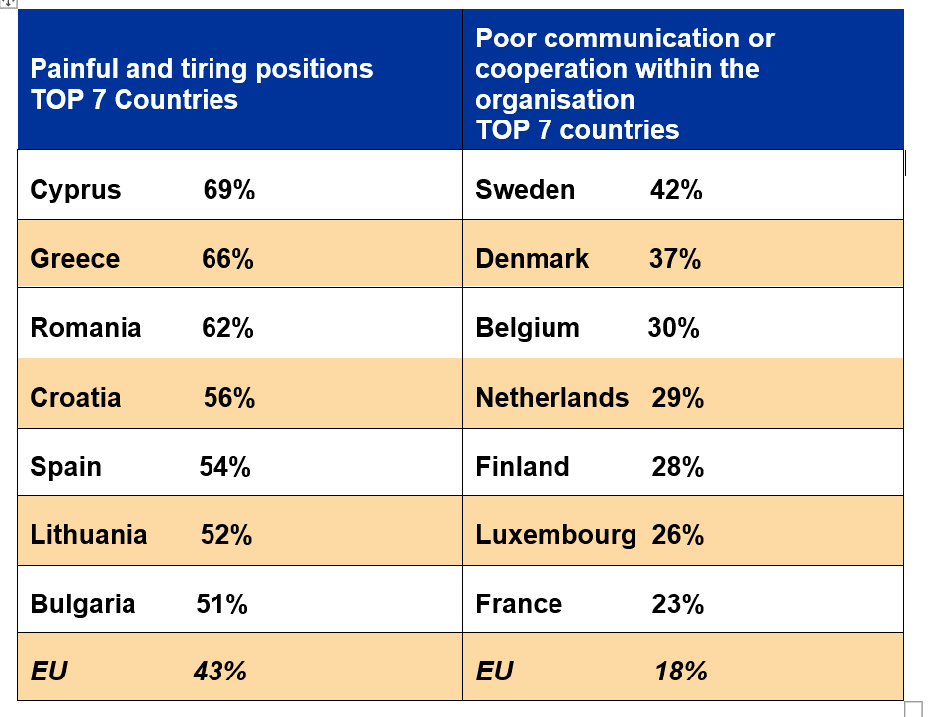
Evidence from the EU OSH Information system
Countries reporting physical risks / psychosocial risks 2019 (European Working Conditions Survey – EWCS 2015)

Slide 14
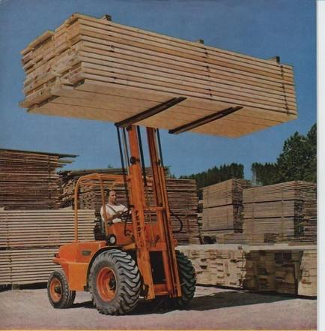
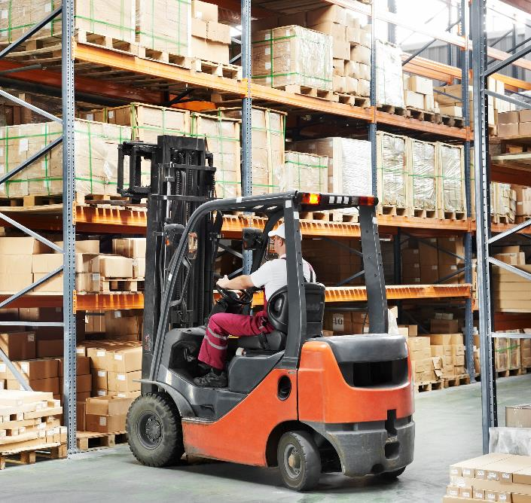
Evidence from the EU OSH Information system
Safety risks – positive developments (more under ‘Work accident data*)
Advertisement 1970
Modern forklift
© Fendt Prospekte de
© Kadmy/ Adobe Stock

Slide 15
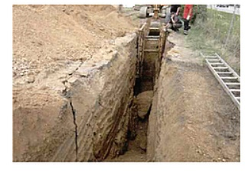
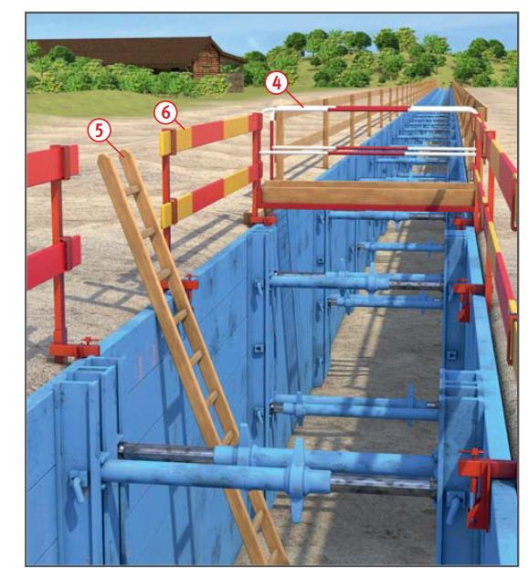
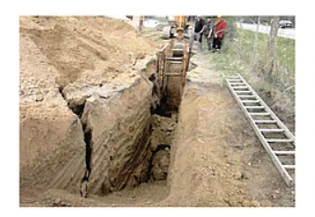
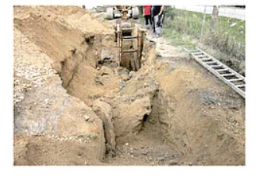
Evidence from the EU OSH Information system
Crushed to death in trenches – one of the main fatal risks at construction sites
© Josef Dreier BG Bau
© H.ZWEI.S Werbeagentur GmbH

Slide 16
Evidence from the EU OSH Information system
Trends of outcomes – accidents at work and
work-related diseases

Slide 17
Evidence from the EU OSH Information system
Outcomes - Accidents at work
Non-fatal accidents at work The incidence rate* dropped between 1998 and 2019 from 4,089 to 1,713 accidents (in the major sectors). This corresponds to a minus of 58%.
Fatal accidents at work The incidence rate* dropped in the same period from 5.03, to 2.17 accidents. This corresponds to a minus of minus 57%.
Serious accidents at work (more then 3 months absence or permanent incapacity)** In 2005, severe accidents accounted for 7.3 % of all non-fatal accidents or roughly 296,000, in 2019 for 9.8% or roughly 232,000. Ratio: 1 fatal accident / 77 severe accidents.
* Incidence rate: accidents per 100,000 employed persons ** Data available only for sectors A, C-N
Notes:
Four major sectors, agriculture, manufacturing, construction and transport, employed less than 40 % of the workforce; in 1998 approx. 39%, and in 2019 31%. In 1998, nearly 64% of the accidents at work took place in these sectors, in 2019 approx. 44% .Thus the reduction of accidents in these sectors was crucial for the overall reduction. In addition, economic developments — sector decline and shift of workforce between sectors — reduced the number of workers exposed to common safety risks in these sectors.

Slide 18
Evidence from the EU OSH Information system
Outcomes – Work-related diseases
WHO and ILO estimates for the EU-27
114,000 work-related deaths per year in 2016.
31 deaths per 100,000 population in working age above 16 years.
International Commission on Occupational Health (ICOH).
ICOH estimates in total 179,000 deaths;
89 work-related deaths per 100,000 labour force.
Notes:
The main reason for these different estimates is the general approach: WHO/ILO restricts their analysis to selected risk-outcome pairs, for example, long working hours as risk and stroke as outcome, whereas ICOH aspired to cover all work-related diseases.

Slide 19
Evidence from the EU OSH Information system
Estimates by WHO/ILO* for EU27, 2016: Deaths due to work-related diseases
* Grouping of diseases by EU-OSHA

Slide 20
Evidence from the EU OSH Information system
Estimates by ICOH* for EU27, 2019: Deaths due to work-related diseases
* Grouping of diseases by ICOH

Slide 21
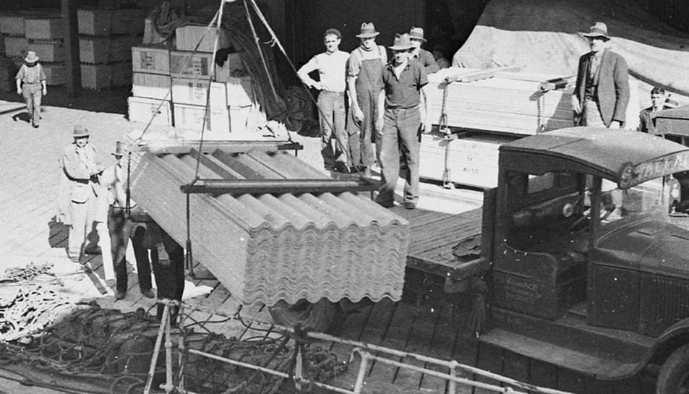
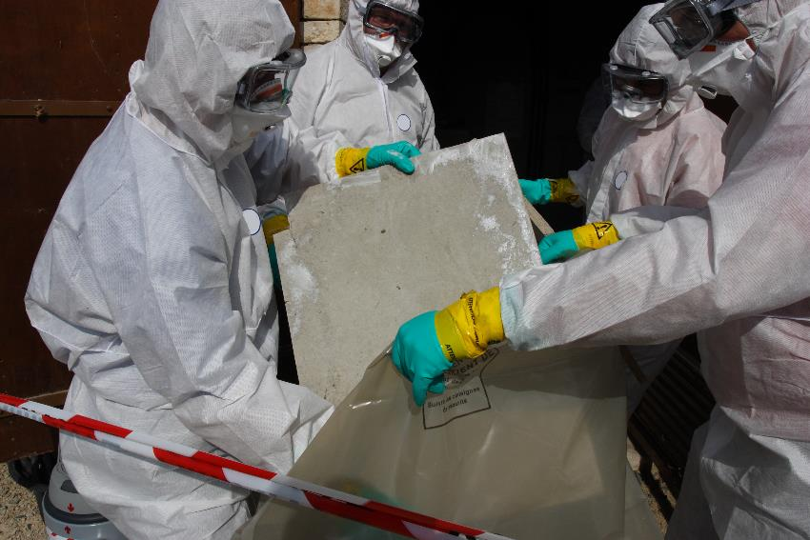
Evidence from the EU OSH Information system
Awareness and preventive measures make a difference - asbestos
© Central Coast Council media, Australia
© Bernard Maurin/ Adobe Stock

Slide 22
Evidence from the EU OSH Information system
Major context developments / mega trends and their influence on OSH
Changes from industrial to service sectors
Skills
Ageing
Contract types
Globalisation
Technological developments Environmental challenges

Slide 23
Evidence from the EU OSH Information system
Share of employment in sectors – 1996 and 2019
Decrease Industry: from 20% to 15%
Agriculture: from 8% to 4%
Increase
Technical, professional and admin. support activities: from 8% to 13%
All other sectors:
No substantial increase nor decrease
Notes:
Four major sectors, agriculture, manufacturing, construction and transport, employed less than 40 % of the workforce; in 1998 approx. 39%, and in 2019 31%. In 1998, nearly 64% of the accidents at work took place in these sectors, in 2019 approx. 44% .Thus the reduction of accidents in these sectors was crucial for the overall reduction. In addition, economic developments — sector decline and shift of workforce between sectors — reduced the number of workers exposed to common safety risks in these sectors.

Slide 24
Evidence from the EU OSH Information system
Skill levels, age and employment types– 2005 and 2019/20/21
Skill levels Three lowest skill levels: Down from 24% to 15% Three highest skill levels: Up from 25% to 36%
Age Share of workers between 55 and 64 up from 11% to 18%
Employment types Employees - plus 13% (2020 approx. 170 m) Part-time - plus 23% (approx. 34 m) Temporary - plus 11% (approx. 23 m) Self-employed - minus 5% (26 m, 18 m without employees, 8 m employers)
Notes:
Four major sectors, agriculture, manufacturing, construction and transport, employed less than 40 % of the workforce; in 1998 approx. 39%, and in 2019 31%. In 1998, nearly 64% of the accidents at work took place in these sectors, in 2019 approx. 44% .Thus the reduction of accidents in these sectors was crucial for the overall reduction. In addition, economic developments — sector decline and shift of workforce between sectors — reduced the number of workers exposed to common safety risks in these sectors.

Slide 25
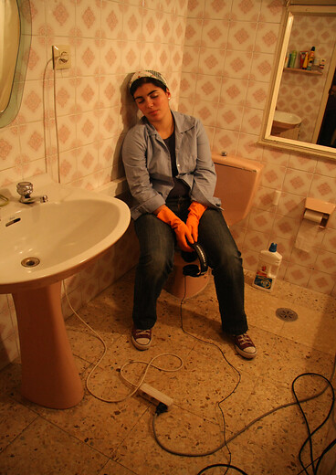
Evidence from the EU OSH Information system
Specific contract types - here domestic work and seasonal work
‘Our study, which to our knowledge is the first one to assess associations between forms of non-standard employment and mortality using population-wide data, revealed considerable mortality inequalities within the salaried employee population in Belgium. Over the subsequent 13 years and three months of follow-up, certain non-standard workers were at increased risk of death compared to permanently employed workers.’
Balogh et al., 2021: Non-standard employment and mortality in Belgian workers: A census-based investigation
Domestic work (flat/house (Photo , DAL, EU-OSHA)
Seasonal work (DAT, EU-OSHA)
Notes:
Approximately 9.5 million people work as domestic workers, 6.3 million declared and approximately 3.5 million undeclared. C189 European Alliance, 2021: Step up efforts towards decent work for domestic workers in the EU: 10th Anniversary of ILO Domestic Workers Convention, 2011 (No. 189) See there in the introductory chapter the difficulties to achieve reliable figures. For more info: ILO, 2021: Making decent work a reality for domestic workers: Progress and prospects ten years after the adoption of the Domestic Workers Convention, 2011 (No. 189) Intra-EU seasonal workers
Between 0.65 m and 0.85 m (2019, EU-27)
Seasonal workers – Extra-EU
Approx. 0.1 m (2019, EU-27)
European Commission: Intra-EU mobility of seasonal workers: Trends and challenges. Final Report, March 2021 (p. 34).
Ibid., p. 36, Table 2. Counted are the TCN, TCN = ‘A person who is not a citizen of the Union within the meaning of Article 20(1) TFEU.’

Slide 26
Evidence from the EU OSH Information system
Globalisation – sharing OSH risks fairly?
The development of global supply chains divides the necessary work related to a product or a service in parts, which might also mean that the occupational safety and health risks might not be shared in a fair or equal way.
Examples: Waste, textiles Examples: Coal mining, specialty chemicals

Slide 27
Evidence from the EU OSH Information system
Technological developments
Transport technologies (container, sea and air freight, logistics)
Material technologies (combined new materials, more plastics, nano)
Environmental technologies (green, circular economy)
Biotechnology (food, pharmaceuticals etc.)
Process and chemical technologies (e.g. batteries, construction chemicals)
Artificial Intelligence based systems for automation (taking over physical and cognitive tasks)
Digital communication technologies (high-speed networks, 5G, IoT, etc.)

Slide 28
Evidence from the EU OSH Information system
Digitalisation / automation and OSH
Important aspects of the changes
What kind of jobs are created?
Sector and industry specific changes
Changes of the work tasks that humans perform
Newly crated forms of employment (e.g. platform work)
Work organisation and OSH Management
Associated health and safety risks considered since the early stages Legislation keeping-up with technological developments
In practice more options for access to real-time data (monitoring, sensors, AI, etc.) → i.e., also for rapid OSH decisions

Slide 29
Evidence from the EU OSH Information system
Environmental challenges
Decentralised energy generating technologies (craft like risk profiles)
New materials and overall chemicalisation (mostly invisible risks)
Circular economy (often ‘dirty’ work)
Climate change* (risks particularly from heat waves and unknown species)
* OSHWiki 2023: Climate Change: Impact on Occupational Safety and Health (OSH), https://oshwiki.osha.europa.eu/en/themes/climate-change-impact-occupational-safety-and-health-osh

Slide 30
Evidence from the EU OSH Information system
Improvements
OSH organisation in enterprises at workplaces
OSH-legislation
Much improved safety technologies and substantially fewer work accidents at work, and mostly less recognised occupational diseases
Better coverage of the variety of risks and workers groups
OSH efforts at international level

Slide 31
Evidence from the EU OSH Information system
Stagnation / Ambiguous Developments
Physical risks still very prevalent and partly increasing, particularly ergonomic risks but also from chemical and biological agents
Minor changes regarding working hours and work at unsocial hours / Stagnation of work intensification for employees since 2005
Difficulties to cope with new forms of work
Difficulties to cope with risks that often require advanced knowledge (psychosocial, chemical and biological, optical, electromagnetic etc.)
Quantitative data on work-related diseases are until now best possible estimates / recognised occupational diseases still dominant for policy making
Increasing psychosocial risks but no massive implementation of practical solutions

Slide 32
Evidence from the EU OSH Information system
Areas of Concern
Few practical OSH solutions for types of work without clear employer - employee relations
OSH in informal, undeclared and illegal work (approx. 16% informal workers in the EU according to DG EMPL)
Physical inactivity
Significant differences between Member States
Supply chains – externalisation of the worst OSH risks outside EU – ethical efforts have limited impact

Slide 33
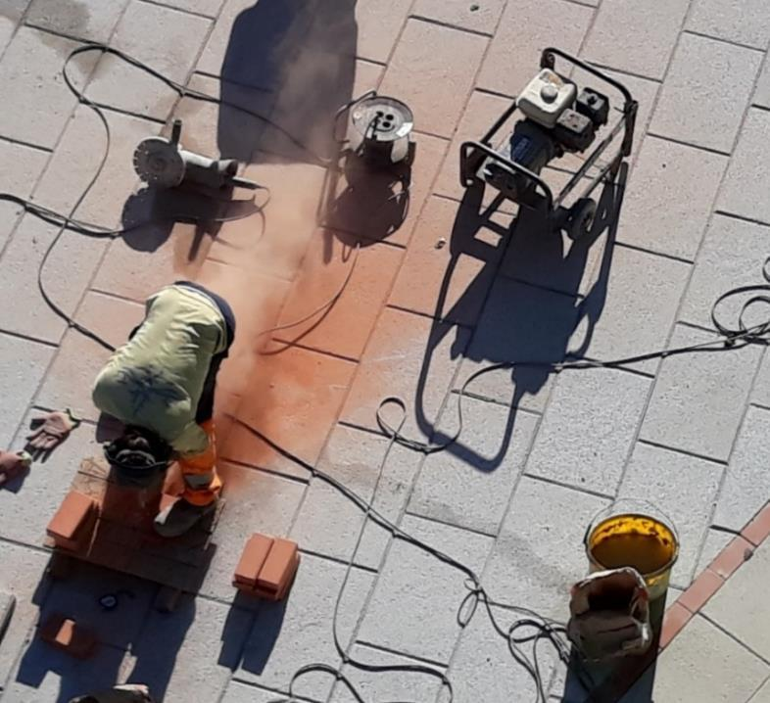
Evidence from the EU OSH Information system
(Nearly) all classical risks in one picture: Accident risk by the grinder, risk of slips, trips and falls by cables, electric shock, exposure to very loud noise, heavy dust, awkward posture, (and not visible): heat and time pressure No dust suppression by water.
© Lothar Lieck

Slide 34
Thank you for listening!
More details in EU-OSHA’s report and summary
‘Occupational safety and health in Europe - state and trends 2023’
or online in the OSH-Barometer:
https://visualisation.osha.europa.eu/osh-barometer/

