Slide 1
SLIC Campaign 2023_2024
Accidents at Work (AAW)
Improving prevention of workplace accidents
Occupational Safety and Health Stocktaking Summit
Stockholm 15-16 May 2023
Maria José Tiago - Chair AAW WG
Fátima Pisco – Co-chair
Labour Inspectors (ACT Portugal)

Slide 2
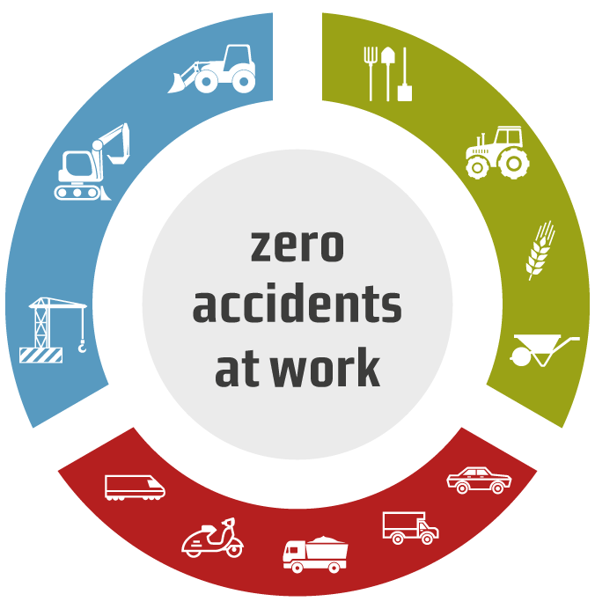
WHY a campaign on accidents at work
All efforts must be deployed to reduce work-related deaths as much as possible
a Campaign to strengthen prevention culture, both in organisations and among individual workers, in line with a Vision Zero approach to work-related deaths in the EU
Campaign AAW 2023-2024 - “Improving prevention of workplace accidents”
SLIC
decided to
organise
SLIC Campaign 2024 - AAW

Slide 3
WHY a campaign on accidents at work
EU Strategic Framework on Health and Safety at Work 2021 – 2027
Risk prevention and the promotion of safer and healthier conditions in the workplace are key to improving job quality, working conditions and promoting competitiveness
Keeping workers healthy has a direct and measurable positive impact on productivity and contributes to improving the sustainability of social security systems
Preventing workers from suffering serious accidents or occupational diseases and promoting workers’ health throughout their working life is key to allowing them to work for longer
SLIC Campaign 2024 - AAW

Slide 4
WHY a campaign on accidents at work
EU Strategic Framework on Health and Safety at Work 2021 – 2027
It will promote the ‘Vision Zero’ approach to work-related deaths by:
Improving data collection on AAW and occupational diseases and analysing the root causes for each work-related death or injury
Strengthening enforcement (with SLIC support it will contribute to raising awareness in companies, sharing good practices and training for labour inspectorates)
SLIC Campaign 2024 - AAW

Slide 5
WHY a campaign on accidents at work
IN 2020
more than a fifth of all fatal accidents at work in the EU took place within the construction sector
IN 2020
70 % of all non-fatal accidents at work in the EU caused wounds and superficial injuries, dislocations, sprains and strains, or concussions and internal injuries
IN 2020
Over 3 300 fatal accidents at work occurred
and 2.7 million non-fatal accidents resulted in at least four calendar days of absence from work in the EU
Accidents at work statistics – 2020*
* Information from Eurostat about “Accidents at work – statistics on causes and circumstances, in 2020”
SLIC Campaign 2024 - AAW

Slide 6
WHY a campaign on accidents at work
Preventing work-related deaths will only be possible by:
investigation of accidents and deaths at the workplace
identifying and addressing the causes of these accidents and deaths
increasing awareness of the risks related to work-related accidents, injuries and occupational diseases
strengthening enforcement of existing rules and guidelines
SLIC Campaign 2024 - AAW

Slide 7
WHY a campaign on accidents at work
AAW Campaign - Aims
Broadening knowledge on how to carry out investigation of accidents at the workplace, in order to identifying and addressing the causes of these accidents
Increasing awareness of the risks related to work-related accidents and injuries by:
i) providing sector-specific information primarily targeted at micro and SMEs
ii) providing guidance for accident investigation procedures, outlining the methodology for establishing the root cause of the accident
SLIC Campaign 2024 - AAW

Slide 8
WHY a campaign on accidents at work
AAW Campaign - Aims
iii) promoting workers and their representatives’ participation in the investigation of work-related accidents and subsequent prevention measures to be adopted
iv) sharing good practices
Strengthening enforcement of existing rules and guidelines
Cooperate with EU-OSHA and its national focal points, taking advantage of their information materials and disseminating them
SLIC Campaign 2024 - AAW

Slide 9
WHY a campaign on accidents at work
AAW Campaign - Goals
All MS will participate in the campaign
MS choose the number of inspections they will carry out. However, at least 21 inspections per MS should be carried out
All MS use common inspection documents (questionnaire/ checklist) produced by the project group
All MS report their national results to the project group using a common template
The project group compiles the data from the MS, prepares a project report and delivers it to SLIC for approval
SLIC Campaign 2024 - AAW

Slide 10
WHY a campaign on accidents at work
AAW Campaign - Sectors
Activity sector | NACE code
Agriculture and forestry | Section A 01 and 02
Construction | Section F 41, 42, 43
Other passenger land transport Freight transport by road and removal services | Section H 49.3, 49.4
SLIC Campaign 2024 - AAW

Slide 11
WHY a campaign on accidents at work
AAW Campaign - Target audiences
Workers, employers and their representatives in the sectors of activity where the campaign will take place, namely micro and SME
Workers, employers and their representatives in the sectors of activity where the campaign will take place, namely micro and SME with high incidence rate, or a high rate compared to the average of their sector of activity
Civil society in general
SLIC Campaign 2024 - AAW

Slide 12
WHY a campaign on accidents at work
AAW Campaign - Timeline 2024
In each MS:
- National Briefing Sessions
Train the trainers
National seminars
Inspections in the field - minimum 21 (total)
Inspections should be made in every sectors
Closing Event
Jan | Feb | Mar | Apr | May | Jun | Jul | Aug | Sep | Oct | Nov | Dec
16/17 - Train the trainer event
In each MS:
- National Briefing Sessions
Train the trainers
National seminars
Interim
country reports
Final country reports
- Campaign report
- Presentation at SLIC Plenary meeting
Update campaign at
SLIC Plenary meeting
SLIC Campaign 2024 - AAW

Slide 13
WHY a campaign on accidents at work
AAW Campaign - documents
Campaign guide
Checklist for inspection visits
EU survey
Interim and final reports
Incident Investigation – information document
Accident type - information documents:
Agriculture | Construction | Road Transport
Crushing by tractor overturning | Crushing by forklift overturning | Body movement under or with physical stress
Slips, trips and falls at the same level | Falling from height_rooftop | Lost control of machine, tool, handling equipment
SLIC Campaign 2024 - AAW

Slide 14
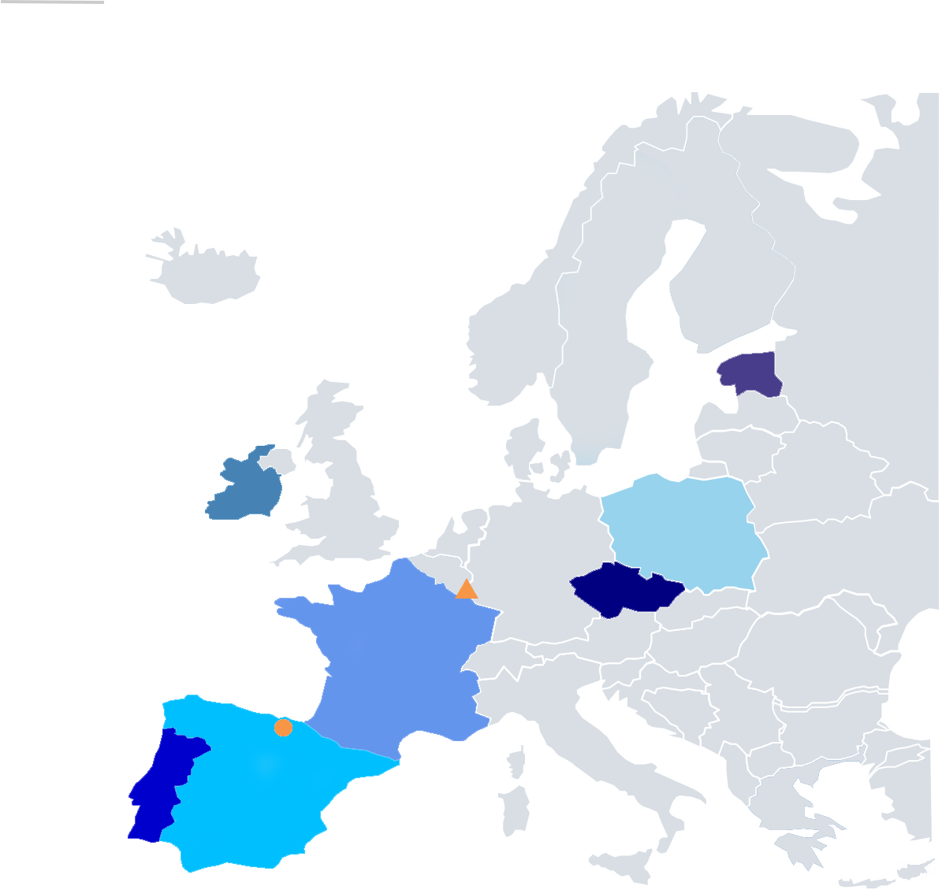
WHY a campaign on accidents at work
The Working Group
Aidan Kelly Ireland
Anneli Metsalu Estonia
Bogdan Solawa Poland
Cécile Riboli France
Juan Ignacio Gomez Spain
Simona Zajícová Czechia
Fátima Pisco Portugal
Maria José Tiago Portugal
Francesca Cavallin
Maria Teresa Moitinho SLIC Secretariat
Tim Treganza EU OSHA
SLIC Campaign 2024 - AAW

Slide 15
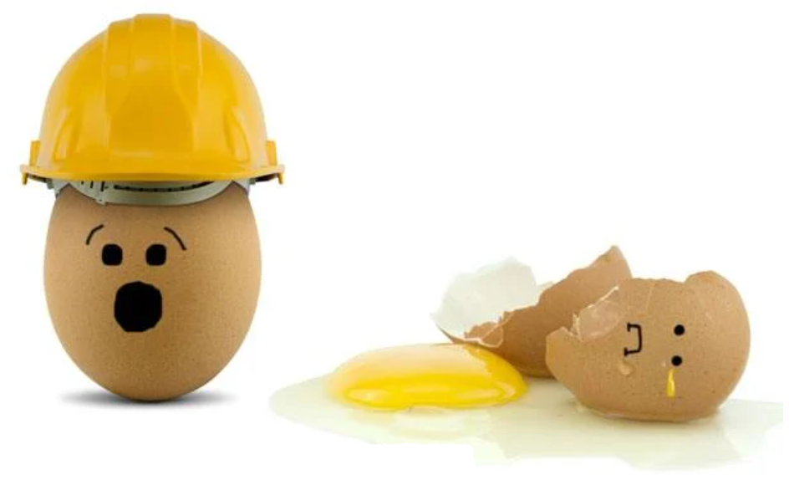
WHY a campaign on accidents at work
SLIC Campaign 2024 - AAW

